Slide 1
K-means Clustering in Python
K-means clustering is a clustering algorithm that aims to partition n observations into k clusters.
There are 3 steps:
Initialization – K initial “means” (centroids) are generated at random
Assignment – K clusters are created by associating each observation with the nearest centroid
Update – The centroid of the clusters becomes the new mean

Slide 2
Steps:Initialization
Assignment and Update are repeated iteratively until convergence
The end result is that the sum of squared errors is minimized between points and their respective centroids.
We’ll do this manually first, then show how it’s done using scikit-learn
Let’s view it in action using k=3:

Slide 3
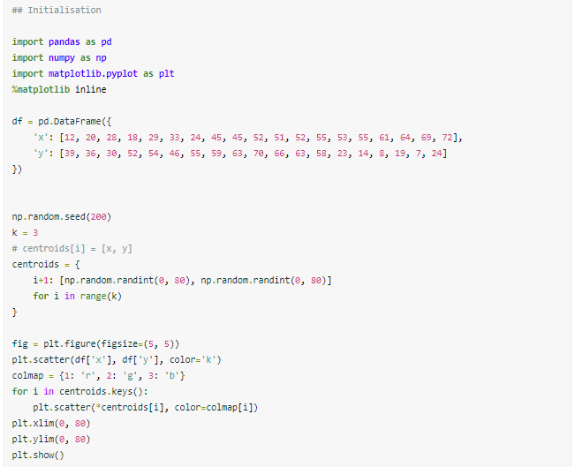
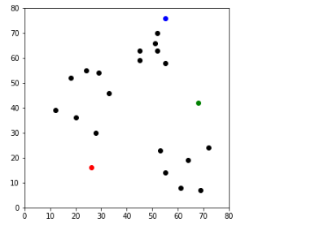
Output

Slide 4
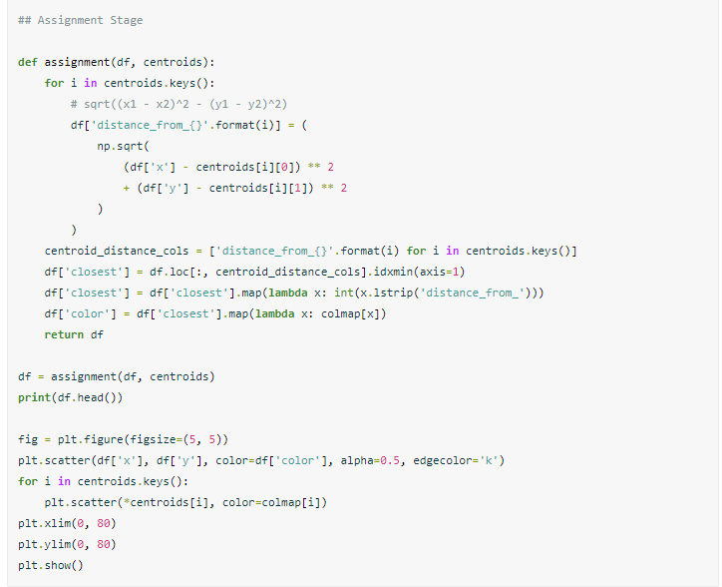
Assignment step

Slide 5
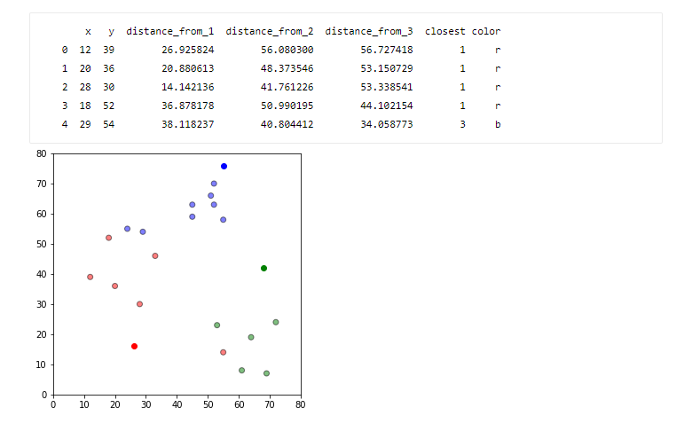
Output

Slide 6
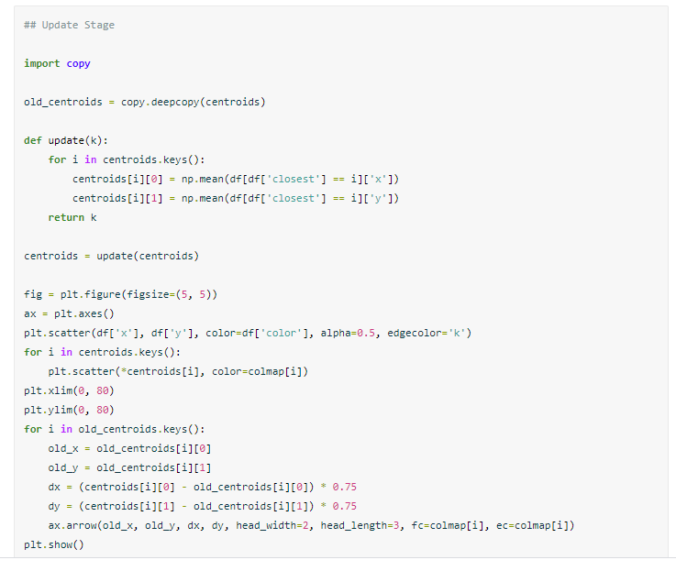
Update centroids

Slide 7
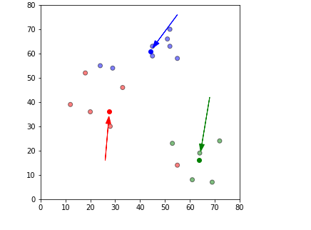
Output

Slide 8
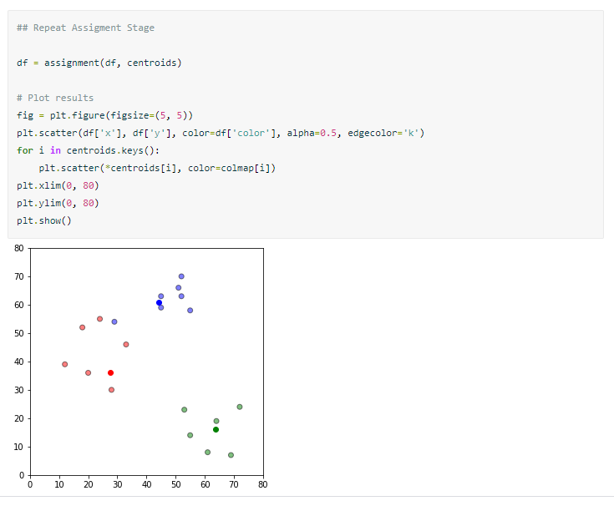
Repeat the assignment step

Slide 9
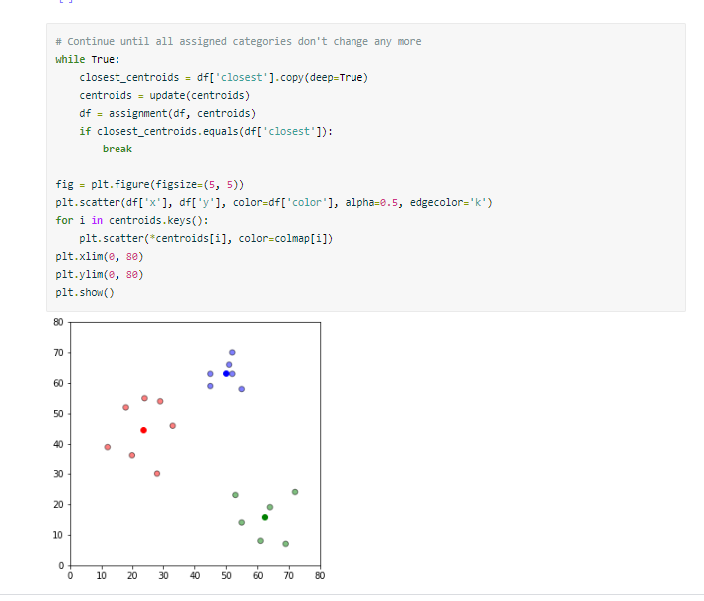
Conti…

